Slide 1
Getting Started with Data Science Fintan Guihen

Slide 2
About Me
Working with SQL Server based Enterprise Systems for over 12 years
Started on SQL 2000 through to SQL 2014 CTP
Data Specialist (DBA, BI, Integration, Analysis, Architecture)
Particularly interested helping clients make the most of their data
Not a Data Scientist
Twitter: @Schmintan
eMail: fguihen@Hotmail.com

Slide 3
Agenda
Aim
What Does a Data Scientist Do
Requirements to Practice Data Science
Case Study – Irish House Prices
Findings
Case Study Breakdown
Tools
Mathematical knowledge
Domain Knowledge
Where To Start
Questions
Notes:
-This is a level 200 presentation – not a deep dive
-Basic demo on using various features

Slide 4
Aims
Lower the perceived cost of entry into Data Science
“I knew all that already”!
Deep understanding of maths not required
Learn the basics through use
No such thing as Failure
Lessons in dead ends
Notes:
Anyone can do data science

Slide 5

What Does a Data Scientist Do?
Identify patterns, trends, answer specific questions & extract Meaning from Data obtained from many different sources
Extract (ETL)
Clean
Feature Generation
Analysis & Domain understanding
Visualize
Automate
Notes:
Stare at mathemathical formulas all day!
Of Course Full time Data scientists do lots more but you can start small.

Slide 6
What Does a Data Scientist Do?
Any Role can have data science tasks and responsibilities
Role | Utilized Skills | Skills utilized by All
Developer | Automation, Visualization | Domain Knowledge, Cleansing
DBA | ETL
Data Warehousing | ETL
Testing | Visualization
Analyst | Analysis
Infrastructure | Analysis, Visualization
Notes:
Any IT based role contains multiple data science skills

Slide 7
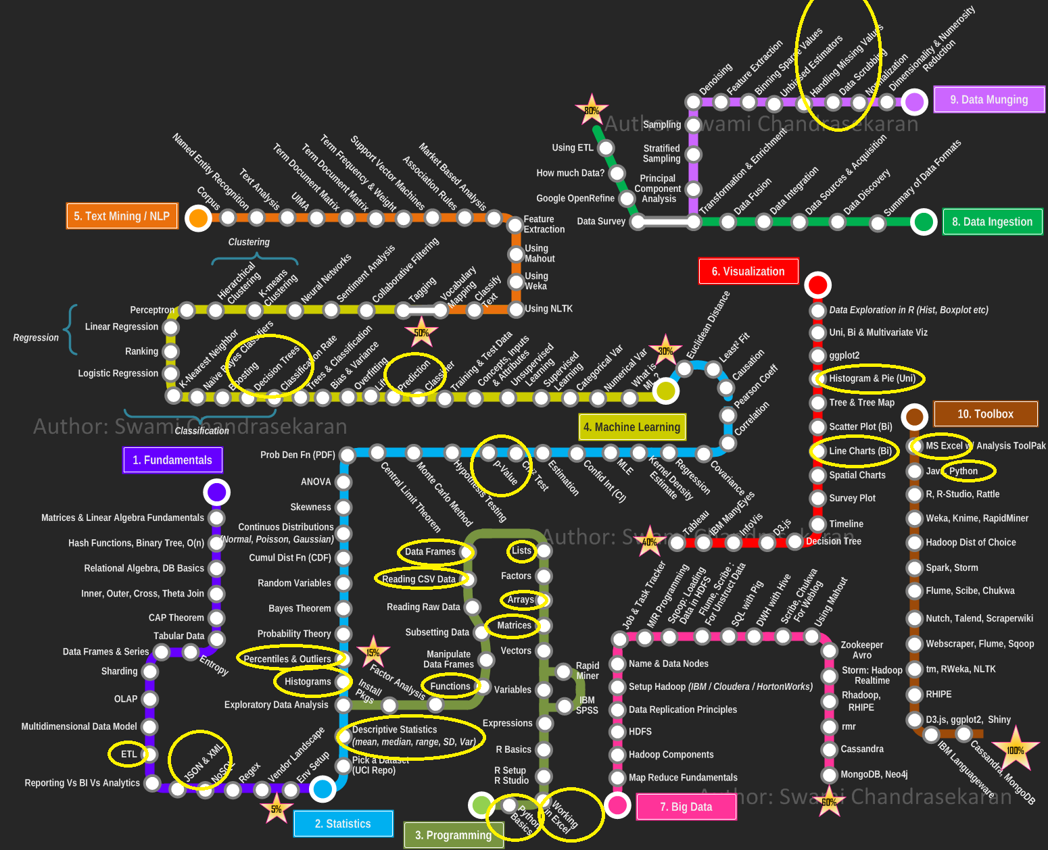
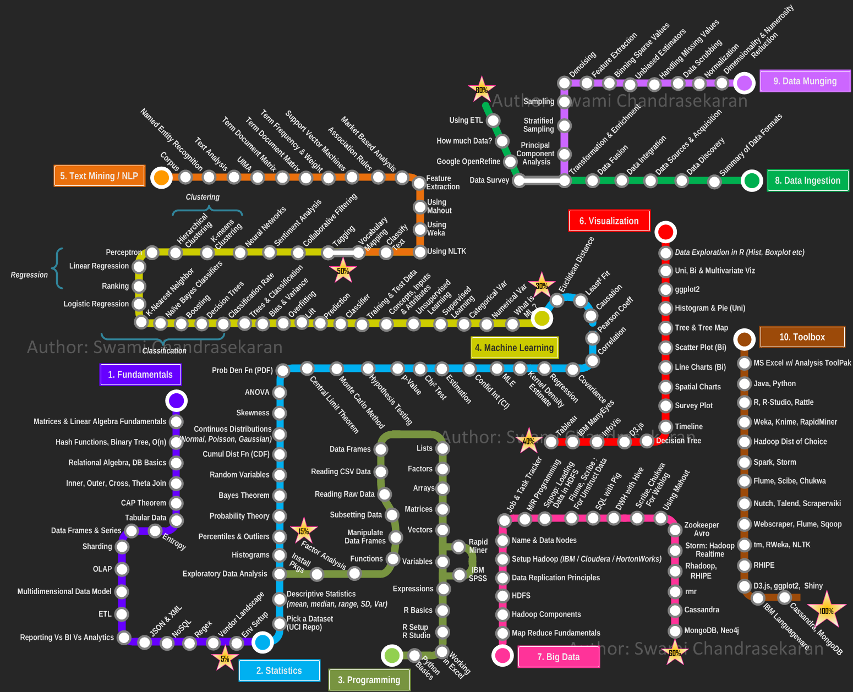
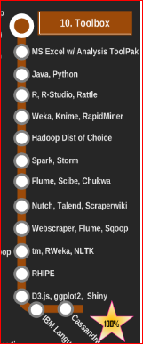
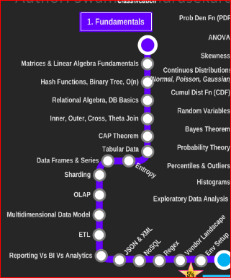
Necessary Skills
Notes:
searching online provides pictures like this or lists of mathematical topics to master first.
Linear Algebra
Calculus
Statistics
probability
Matrix
Hinders aspiring data scientists, makes mountain of knowledge look insurmountable.
Is OLAP a fundamental? Regex is useful, but fundemental.?
Learn What you need when you need it: this project included: Python, Understanding of Linear Algebra, ETL, Data format management, ETL, List, Matrices, Arrays, Descriptive Stats, P Value, histograms, line charts, Data Acquisition.

Slide 8
Necessary Skills
A working knowledge of “The Basics”
Statistics
Descriptive statistics - Mean, Median, Mode
Percentages
Machine Learning
Linear & Decision Tree Regression
Toolset/platform(s) to
process data
visualize data
Notes:
Working knowledge means an understanding of how they work.
Does NOT mean an intricate knowledge of formulas etc.
Let libraries and platforms do the heavy lifting.
Can use sql server to run python scripts but not a dev environment.

Slide 9
Obtaining Skills
Take Stock of what you already have
MOOC’s
User Groups
Dive in – Pick a case study
Notes:
You often have a lot of the skills already.
MOOC’s are excellent quality nowdays. List in appendix
Data science User group is very good, also python, R and platform specific groups around the city
Pick a case study and dive in

Slide 10
Case Study: How Affordable is Housing in Ireland
Questions:
Can someone on “Average” wage afford housing:
In Ireland
In Dublin
How much of “affordable” housing is multi bedroom – for Families?
What locations are priced towards Average Salaries

Slide 11
Definitions & Assumptions
Average Salary: 38.2K as of 2017 Q4 - CSO
Assuming no other savings besides deposit
Max Loan Amounts(Thousands)
Cutting off tail greater than 1 million euros.
Figures based on asking price, not selling price
Buyer | Salary | Loan Multiplier | Deposit | Total
FTB | 38.2 | 3.5 | 13.3 | 147.1
FTB Joint | 76.4 | 3.5 | 26.7 | 294.1
STB | 38.2 | 3.5 | 26.74 | 160.4
STB Joint | 76.4 | 3.5 | 53.5 | 320.8
Notes:
Average salary not the best measure (median or mode). (5 people on 20k & 1 person on 1 million gives average salary of 183k
Eliminating variables such as savings etc.
Removing some sku

Slide 12
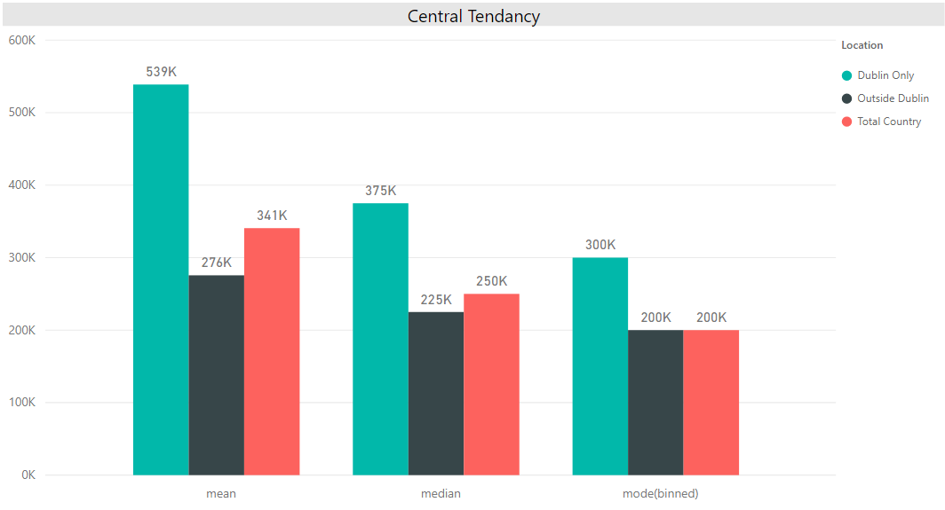
High Level Statistics
Average Price Comparison flawed due to skew
Med & Mode indicate Dublin is roughly 33% more expensive
Largest number of Dublin properties in the 280-300k bracket.
Largest number of properties outside of Dublin in 180-200k bracket.
Notes:
skew in Dublin prices influences Mean.
Houses grouped by price in bins incrementing by 20k

Slide 13
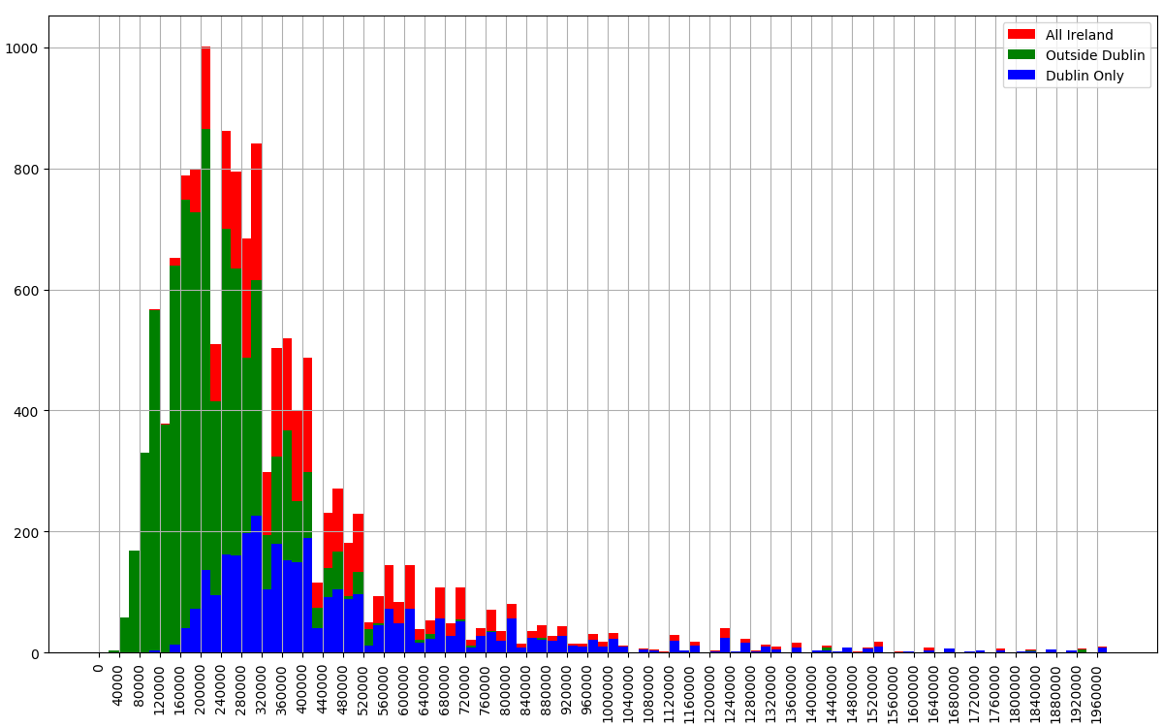
Housing Availability for Average Income (Corrected Sale Price)
Joint FTB 7% in Dublin (987)
51% outside Dublin (7006)
Individual FTB (147.1K)
0.2% in Dublin, 27
17% outside Dublin, 2371
Joint FTB (294.1K)
7% of in Dublin, 987
51% outside Dublin, 7006
2nd Time Buyers have higher max due to higher deposit
Individual
0.4% in Dublin, 63
22% outside Dublin, 3030
Joint
9.1% inside Dublin, 7610
56% outside Dublin, 1235
Individual FTB
0.2% in Dublin (27)
17% outside Dublin (2371)
Notes:
Individual FTB: 0.8% of Properties against Total Dublin Sample
Joint FTB: 29% of Properties against Total Dublin Sample

Slide 14
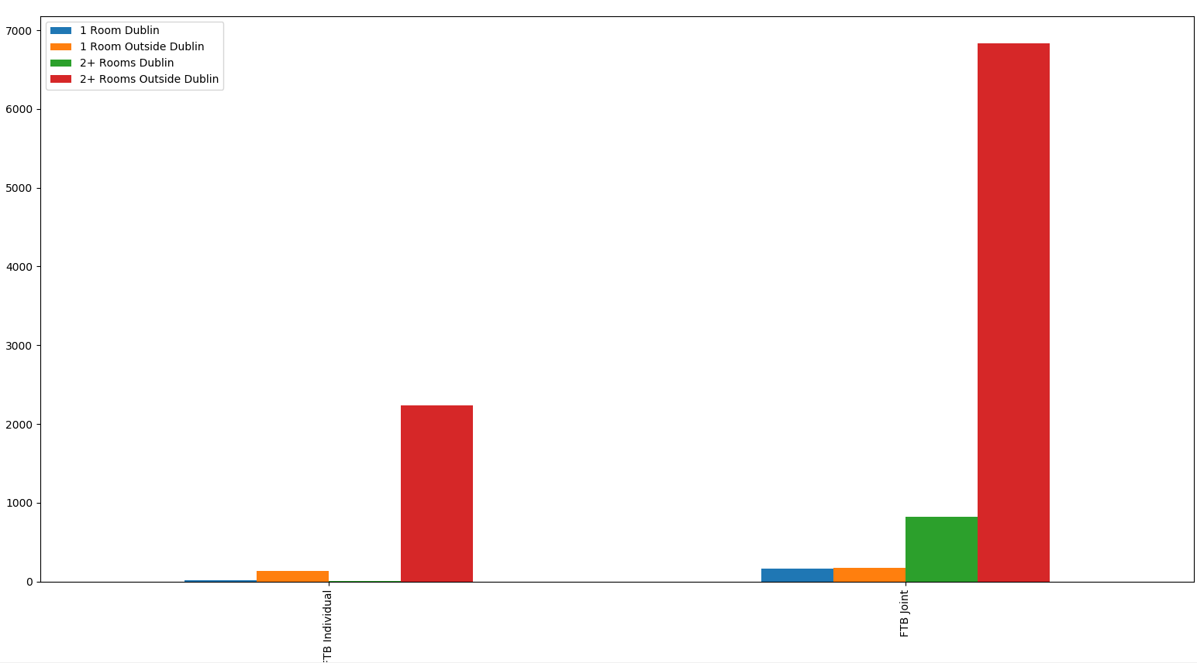
Properties with > 1 Room
Families require more than one bedroom.
 | 2+ Rooms in Dublin | 2+ Rooms Outside Dublin
Individual FTB | 9 | 2237
Joint FTB | 826 | 6837
Notes:
Families need two incomes to afford property

Slide 15
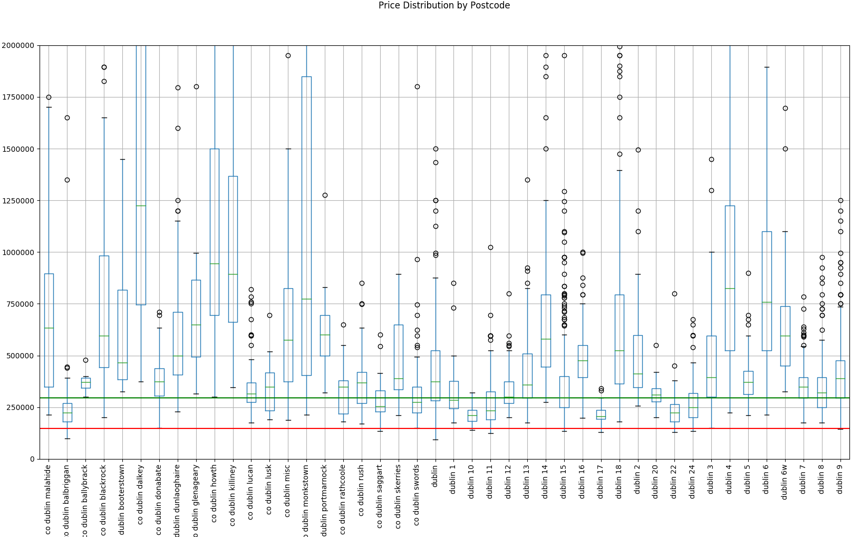
Dublin Price Distribution
N.B – Shows Distribution, not quantities
Joint FTB:
Balbriggan, D11, D15, D8, D22, D24
Individual FTB:
Balbriggan, D15, D17.
All very low percentiles

Slide 16
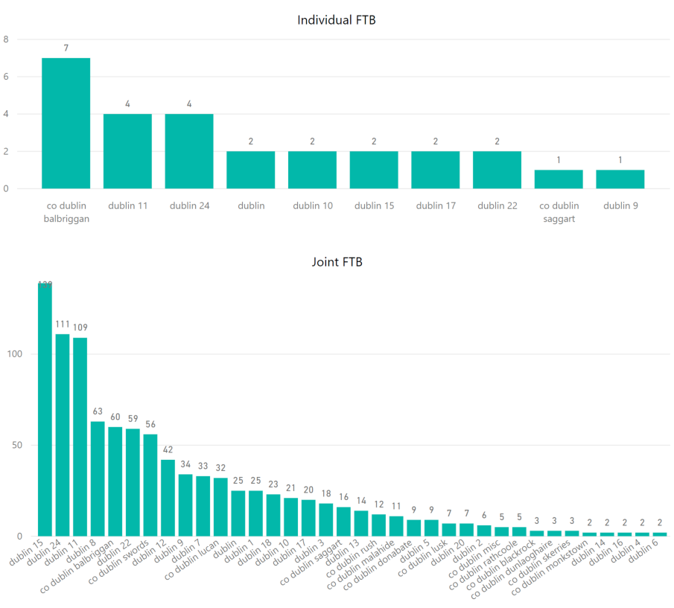
Location – Within Dublin
North & West Dublin
D15 – Blanchestown, Ashtown, Clonsilla, Ongar, Clonee, Tyrrelstown
D24 – Tallaght, Citywest, Firhouse, Ballycullen
D11 – Finglas East, Glassnevin
D8 – SCR, Inchicore, Rialto, Christchurch, Kilmainham
D10 – Ballyfermot, Cherry Orchard
Little option for Individuals
Notes:
D15 – Blanchestown, Ashtown, Clonsilla, Ongar, Clonee, Tyrrelstown
D24 – Tallaght, Citywest, Firhouse, Ballycullen
D11 – Finglas East, Glassnevin
D8 – SCR, Inchicore, Rialto, Christchurch, Kilmainham
D10 – Ballyfermot, Cherry Orchard

Slide 17
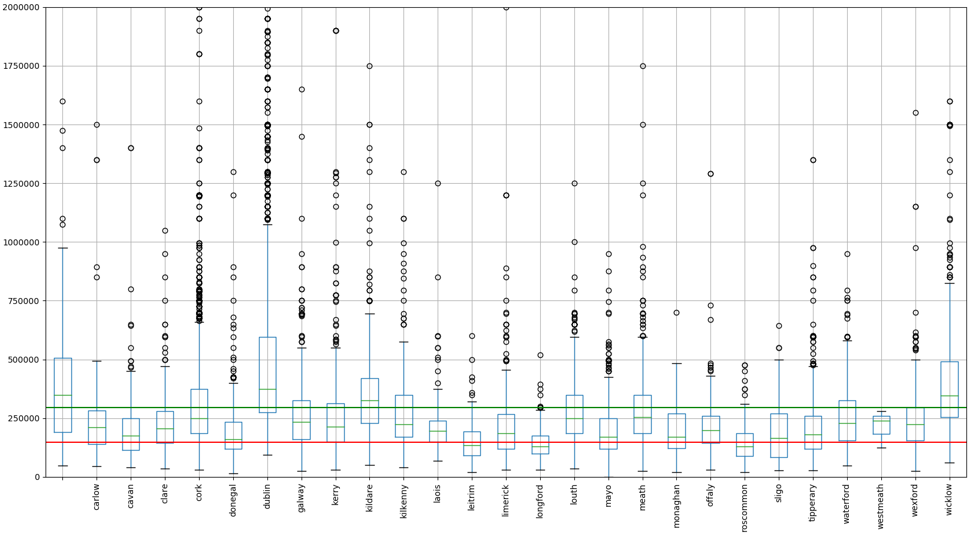
Full Country Price Distribution
N.B – Shows Distribution, not quantities
More options in West of Ireland
Picture looks better for individual FTB’ers
Notes:
Individual FTB’ers above 25th percentile in West Leitrim, Longford, Roscommon, Sligo, and further south in Tipp & Longford
Joint FTB’ers borrowing limit above 50th percentile in most counties.

Slide 18
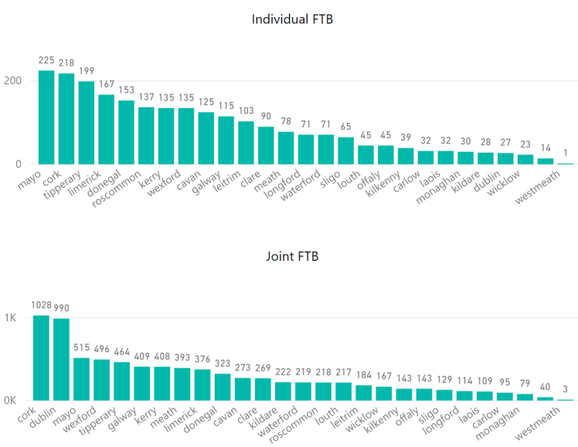
Location – Outside Dublin
More choice for Individuals
Cork
Dublin ranks highly for Joint FTB’ers
Indicate shortage countrywide?
Notes:
Cork contains a large City, potentially good destination – employment and housing.
Dublin 2nd for joint buyers

Slide 19
Conclusions
Individual First Time Buyers have very little options in Dublin
Decentralisation, Longer Commutes
Dublin prices demand two incomes
Families (2+ bedrooms) within Dublin have little choice
Single income families have no choice
North & West Dublin cater to “Average Wage”
Second Time Buyers have higher limit but only due to higher deposit
Inability to raise deposit may hinder Second Time Buyers
Many more options outside Dublin
Overall numbers of property available is still very low

Slide 20
Questions?

Slide 21
Environment
Anaconda distribution of Python
PowerBI
Data Storage – SQL, CSV
Notes:
Anaconda, easy to use installer, many libraries included, comes with good IDE.
PowerBI, because im familiar with it

Slide 22
Dataset
Property for sale
Snapshot from popular property website, mid Feb 2018
Obtained via “Screen Scraping”
Python - selenium, Beautiful Soup
12.9k distinct clean rows
Sample – not full population
Biased?
Notes:
Biased? Only accessable to sellers who use the internet. Small bias but illustrates the problem

Slide 23
Obtaining Datasets
Demo

Slide 24
Cleansing (Data Munging)
Clean and shape the data into something usable
Consumes roughly 90% of the total time
Python, excel, SQL, PowerBI
Decisions to make:
When to discard data
How to populate missing values
Feature Generation
Price Binning
Location

Slide 25
Analysis & Visualization
Define clear quantifiable questions
Basic understanding of Stats – Mean, median, mode, box plot
Good understanding of the data domain
Regions, Deeper dive into Dublin, BER, single/multi room
Python
Pandas
Numpy
Matplotlib
PowerBI
Notes:
Quantifiable questions are required. Random exploration usually fruitless.
Advanced maths not required.
Domain Knowledge:
Dublin needs individual exploration
Families require multiroom
BER, what is it
Pandas – Data analysis functionality similar to R
Numpy – advanced mathemathical functionality for python & useful data structures
Matplotlib – plotting library for Python

Slide 26
Lessons in Dead Ends
Some questions/Analysis cannot be answered
Dataset too small
Missing Features
Sparse Columns
Biased Data
Skill Level
Machine Learning

Slide 27
Prediction & Machine Learning
Predict price based on size, location, BER & No. Rooms.
Poor accuracy, Mean Squared Error of 350K
Reasons:
Low correlation between No. Beds, Baths, Size & Price
Mostly based on categorical variable – Location
Require reasonable sample for every street in the country
Pricing granularity, varies from street to street.
3 bed A1 BER - Citywest: 309k, Kiliney: 720k
4 Bed A2 BER Kildare, same Estate, 305K, 420K
Many areas with very low number of properties
High Price fluctuation over short period
My Experience Level
Notes:
Thought there would be clear correlation.

Slide 28
Next Steps
Prediction
Obtain more data over time
Refine features based on more granular address
Better data allows New Questions
Selling rate based on location
Asking Price vs Selling Price
Obtain more granular salary values
Mean in Dublin vs rest of country
Median & mode for more rounded view

Slide 29
Lessons Learned
Get the basics right
Naming Conventions
Code reuse
Data types
Ask specific questions
Find balance between productivity & learning
Bigger = Better (Data Volumes)

Slide 30
Summary
Most IT Professionals already Practice Data Science
Basics are not difficult
Learn concepts, let the tools do the heavy lifting
Domain Knowledge is crucial
Case study
Obtain data - Screen Scraping
Process data(Munging) - 90% of the work
Toolsets (Python, PowerBI)
Find balance between productivity & education
Failure provides learning opportunities
Notes:
ETL, Cleansing, analysis already done by DBA’s, ETL Devs Architects etc.
Basics Mean, Median, Mode, Python loops, functions etc all relatively easy
Provide API’s with good input data, know how to interpret what they output and have an understanding of what they do. Deep knowledge not necessary
Learn the intricates of your domain.
Munging largest task but you’ve done it before.
Pick a toolset you know or you want to learn
If time is short use tech you know, if you have time learn to use a new toolset
Always find a benefit to a dead end

Slide 31
Questions?

Slide 32
References
CentralBank – Mortgage Measures
FTB
Single person Avg Mortgage: (38.2 x 3.5) = 133.7 + 13.7(deposit) = 147.4K
Couple Avg Mortgage: (38.2 x 2) x 3.5 = 267.4 + 26.7 deposit = 294K
STB
Single person Avg Mortgage: 133.7 + 26.74(deposit) = 160.4K
Couple Avg Mortgage: 267.4 + 53.5(deposit) = 321K
CSO Earnings
Property Price Register
Property Website

Slide 33
Appendix

Slide 34
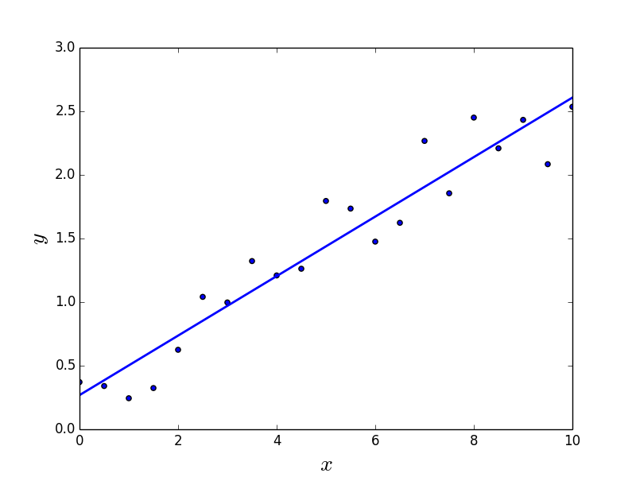
Linear Regression Desc

Slide 35
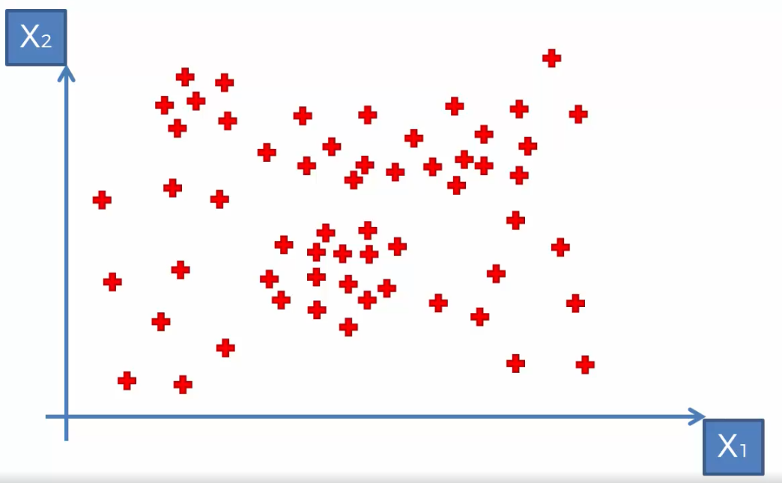
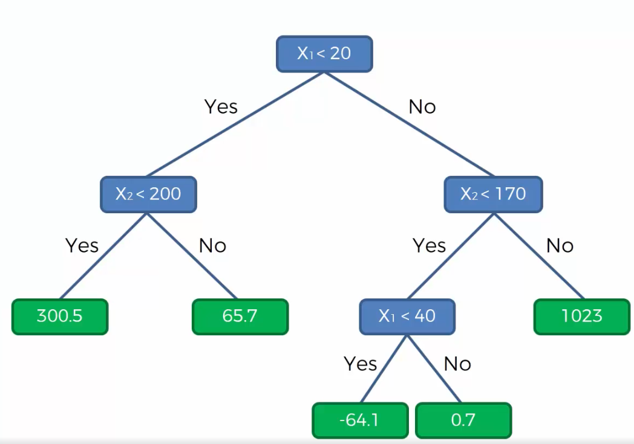
Decision Tree Desc
65.7
1023
200
170
300.5
0.7
-64.1
20
40
Notes:
Algorithm decides the splits. Stops when its not adding useful information to the model (information entropy)

Slide 36

Random Forrest
Souped up Decision Trees
100’s of Decision trees built based on Random Sampling
Predict value in each tree
Calculate Average value from all trees – Result
Good for ironing out variation in dataset
Reduces chances of poor prediction*
E.g. Guess number of beans in jar
1 guess vs average guesses

Slide 37
Normal Distribution

Slide 38
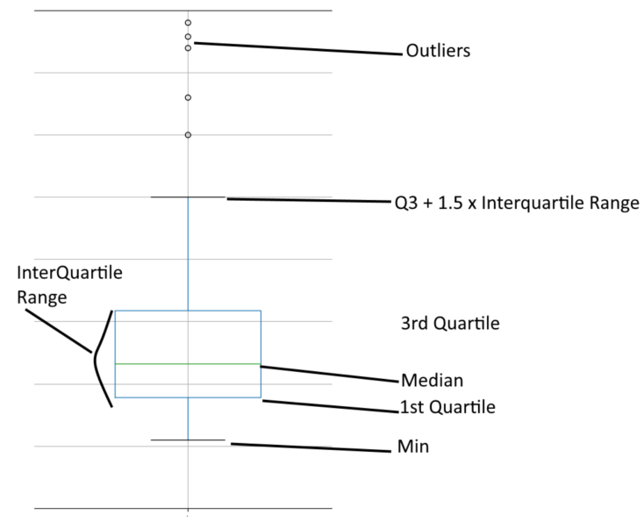

BoxPlot
Shows Distribution
Kind of like histogram on its side
Does not show quantities

